Slide 1

Developing standards and accompanying elements of a standards-driven quality improvement initiative.

Slide 2

Identify the intended beneficiaries
Define the health outcomes to be achieved
Define the health services and commodities to be delivered to achieve these health outcomes
Identify the health service and commodity delivery points
Identify the problem statements (the gap between desired quality and actual quality)
Formulate the quality standard statements
Choose the set of criteria to be achieved for each quality standard to be achieved
Identify the actions to be taken at national, district and local levels for the criteria to be achieved
Specify ways and means to verify the achievement of the criteria
Outline the preparatory work that needs to be done at the national level before the quality standards can be applied
Notes:
Inform the working group that you will take them through the ten tasks outlined in this slide.

Slide 3

1. Identify the intended beneficiaries
What is the population segment (e.g. 10–19 years) we want to address? Why?
Within this, which population group do we want to focus on? (E.g. those living and working on the street).
Why?
Notes:
This first task for the working group is to identify the main beneficiaries of the national quality standards:
1.What is the population segment (e.g. 10-19 years) we want to address ? Why ?
2. Within this population segment, which population group or groups (e.g. those living and working on the street) do we want to focus on ? Why ?

Slide 4
2. Define the health outcomes to be achieved
What are the health outcomes we want to achieve?
Why?
Notes:
This second task for the working group is to specify the main health outcomes to be achieved and the reasons for this.
Note: A health outcome or result can be stated as a positive state achieved (e.g. improvement in the nutritional status indicated by the body mass index) or a negative state prevented (e.g. reduction in the levels of anaemia ).

Slide 5
3. Define the health services and commodities to be delivered to achieve these health outcomes
What are the health services to be provided in relation to each of the health outcomes above?
Notes:
This third task for the working group is to identify the package of health services to be achieved.
Note: For each health outcome, the group needs to specify each of the following services to be provided at the point of delivery:
Whether information provision is to be done
Whether counselling services are to be provided
Whether any promotive, preventive or curative health services are to be provided
In addition, the group needs to specify in what circumstances the patient should be referred for health and social services at the next level of care.

Slide 6
4. Identify the health service and commodity deliver points
Where are the health services to be provided?
Where are the health-related commodities to be provided?
Notes:
This fourth task for the working group is to identify where the health services are to be provided.
Note: This will depend on which groups of adolescents are to be reached, and what health services and/or commodities are to be provided.

Slide 7
5. Identify the problem statements (the gap between desired quality and actual quality)
How does each of the health service delivery points/health-related commodity delivery points relate to the desired quality?
Notes:
This fifth task for the working group is to identify the main problems that need to be addressed.
Note: A problem is defined as a gap between 'required quality' and 'actual quality'.

Slide 8
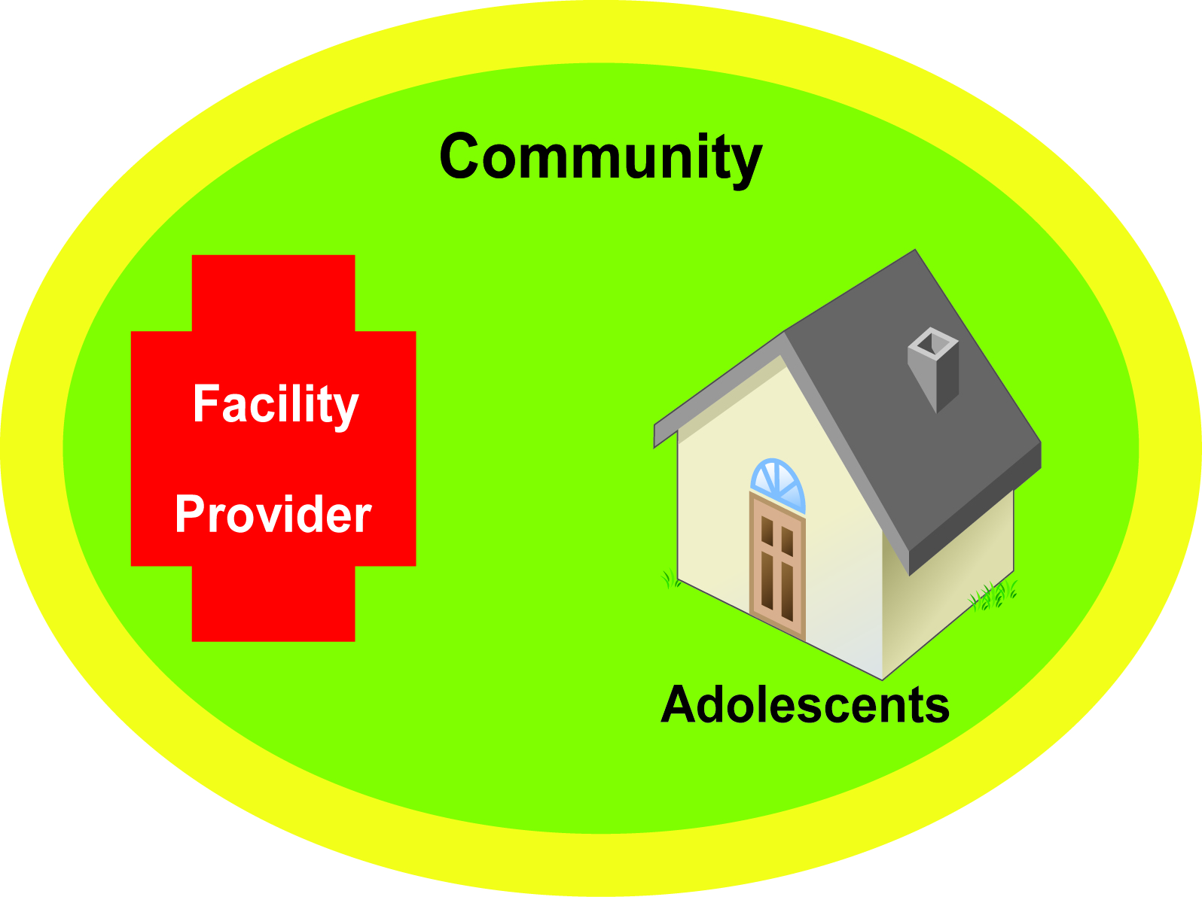
'Required' quality
of health service provision to adolescents.
Points of service delivery:
- enable adolescents to obtain the health services they need
- are appealing to adolescents & respectful of them
- provide the health services that adolescents need
Community members support the provision of health services to adolescents.
Adolescents
- are aware of what services are being provided
- are (& feel) able & willing to obtain the health services they need
Service providers:
- are non judgemental & considerate in their dealings with adolescents
- deliver the services in the right way
Notes:
Ask the working group to identify problems (i.e. gaps between required and actual quality) in four areas:
Points of health service delivery.
Health service providers
Community members
Adolescents.
Ask a member of the working group to read aloud the required quality in each of these four areas.
Then ask them to work together to work together to describe and write a word picture of the actual quality in relation to each of these areas in a typical health service delivery point and its catchment area.
Tell them that there are likely to be problems at other levels (e.g. the functioning of National AIDS Programme or of District Health Management Teams) but that is not the focus of this exercise.

Slide 9
Example from India – Problem statement.
Adolescents are generally not aware of where they can get services.
Identify the main problems
Notes:
Use this evolving example from India to guide the working group through the process of developing standards and accompanying elements of a standards-driven quality improvement initiative.
One of problems identified by the working group developing national standards in India is listed in this slide.

Slide 10
6. Formulate the quality standard statements
When we say that we want to improve the quality of these health service delivery points, what exactly do we mean?
Notes:
The sixth task for the working group is to formulate quality standards in relation to each of the main problems that they identified.
Note: A standard is defined as a statement of required quality. In other words, it is a statement what the situation will be like after the problem has been tackled and successfully addressed.
Move to the next slide.

Slide 11
Example from India – A problem statement & an accompanying standard statement.
Identify the main problems
Adolescents are generally not aware of where they can get services.
Formulate the standards.
Adolescents are well informed about the
availability of good quality health services
from the service delivery points.
Notes:
Use this example to show the working group how to craft standard statements.
Remind them that a standard statement should describe the situation that will result when a problem that has been identified has been tackled and successfully overcome.
Ask them to draft standard statements for each of the problems that they identified.

Slide 12
Example from India: Problem statements and accompanying standard statements– 1
Problem statement 1.
In many situations:
- community members (especially parents) are not aware of the value of providing sexual and reproductive health services to adolescents;
- they do not believe that adolescents should be able to obtain these health services.
This deters health service providers from providing health services to adolescents. It also deters adolescents from seeking health services.
Standard statement 1.
An enabling environment exists in the community for adolescents to seek the health services they need.
Notes:
As they proceed, take the working group through the following four slides which contain the full set of seven problem statements and the standard statements that were drafted by the working group in India.

Slide 13
Example from India: Problem statements and accompanying standard statements – 2
Problem statement 2.
Adolescents are generally not aware of where they can get health services.
Standard statement 2.
Adolescents are well informed about the availability of good quality health services from the service delivery points.
Problem statement 3.
In many places, service delivery points do not provide adolescents with the health services they need.
Standard statement 3.
Service delivery points provide the specified package of health services that adolescents need.

Slide 14
Example from India: Problem statements & accompanying standard statements – 3
Problem statement 4.
In many places, health services are not provided effectively by service providers for a variety of reasons (e.g. service providers are not in place, service providers do not have the required competencies, the required supplies, equipment and basic amenities are not available).
Standard statement 4.
Service delivery points deliver effective health services to adolescents.
Problem statement 5.
Because of a variety of reasons, e.g. judgemental attitudes, service providers in many places are not motivated to serve their adolescent patients.
Standard statement 5.
Service providers are sensitive to the needs of adolescents and are motivated to work with them.

Slide 15
Example from India: Problem statements & accompanying standard statements – 4
Problem statement 6.
Adolescents do not obtain health services because the physical environment and procedures put them off.
Standard statement 6.
Adolescents feel at ease with the surroundings and procedures of the service delivery point.
Problem statement 7.
In many places service delivery points do not receive supervisory visits. If they do, this is often done in a perfunctory and demeaning manner.
Further data that is gathered at sub-centre, primary health centre and community health centres is generally sent to a higher authority for analysis. Often no feedback is received. Only rarely is the data used locally to address problems and fill gaps.
Standard statement 7.
Management systems are in place to improve/sustain the quality of health services.

Slide 16
7. Choose the set of criteria to be achieved for each quality standard to be achieved
What needs to be in place for the quality standard to be achieved?
Notes:
The seventh task for the working group is to choose the criteria needed to achieve each of the standards that they have developed.
Note: The word criteria is used to describe the things that need to be place and the things that need to be happening for a standard to be achieved.

Slide 17
Standard:
Criteria
Input
The things that need to be in place in a health service-delivery point.
The way in which staff at a health service-delivery point deal with adolescents & with other community members..
The desired effect on adolescent users of the health service delivery point & other community members.
Process
Output
Notes:
In formulating the criteria, it is useful to think of
- Input criteria
- Process criteria
- Output criteria
By input criteria we mean the 'hardware' that needs to be in place at a health service-delivery point.
Examples:
A competent health worker.
A notice board listing the opening hours of a clinic.
By process criteria we mean the way in which staff in the health service-delivery point deal with adolescent patients and with other community members.
Examples:
Health workers provide contraceptive information and services as stated in the guidelines.
Support staff are welcoming to adolescents.
By output criteria we mean the desired effect on adolescent users of the health service delivery point and on other community members.
Examples:
Adolescents feel that health workers are concerned about their welfare.
Community members are aware of what health services are being provided by the clinic.
Lead the working group in choosing criteria. In doing this, ask them to take into account two issues:
Potential impact,
Feasibility (in the local context).
Stress that the criteria that they choose need to be:
ambitious but not overambitious,
in line with national laws and policies,
sensitive to the social and cultural norms.

Slide 18
Example from India: Standard statement & accompanying criteria
Input Criteria | Process Criteria | Output Criteria
SDPs display a sign board welcoming adolescents & informing them about the availability of quality health services. | No process criterion. | Adolescents are well informed about the availability of quality health services from Service Delivery Points.
A plan is in place for SDP staff to visit educational institutions in the catchment areas to inform adolescents about the availability of quality health services. | SDP staff are visiting educational institutions to inform adolescents about the availability of quality health services.
A plan is in place to engage organizations (e.g. NGOs) working with children/adolescents on the street) to inform the adolescents they come into contact with about the availability of quality health services. | SDP staff are meeting these organizations to brief them about the availability of quality health services, and to request them to communicate this message.
A plan is in place to engage local performing groups to provide information about the availability of services through folk media. | SDP staff are meeting with local performing groups to engage them in communicating information about the availability of services through folk media.
Information about the availability of quality health services has been posted in pharmacies and shops in the area. | No process criterion.
Information about the availability of quality health services has been provided in the mass media. | No process criterion.
Notes:
Take the working group through the criteria that were chosen to achieve the third Indian standard.
Point out that the first three input criteria (black font) were identified as essential and the last three (blue font) as optional.
Point out the essential process criteria are presented in black font, and the optional one is blue font.

Slide 19
8. Identify the actions to be taken at national, district and local levels for the criteria to be achieved
What needs to be done at the national, district and local levels to ensure that health service provision meets the specified quality?
Notes:
The eighth task for the working group is to identify the actions needed to achieve the criteria.

Slide 20

Different but complementary actions at national, district & local levels.
Providing directions
Providing methods & tools
Providing human & material support
National level
Acting as a bridge between the national level & the district
Playing a facilitating role in the district
Supporting the service delivery points
Supporting community action
District level
Local level
Notes:
The working group needs to identify actions that are required at the national/state, district and local levels.
In doing this, they need to consider the complementary nature of these actions.
For example, a logo for the initiative will need to developed at the national level; officials at the district level will need to provide support to clinics in painting the logo on their notice boards; and clinic managers will need to ensure that their notice boards are not covered by unauthorised posters.
The actions that they identify – just like the criteria they have chosen – need to be:
ambitious but not overambitious,
in line with national laws and policies,
sensitive to the social and cultural norms.

Slide 21
Example from India: Actions needed to achieve criteria – 1. Standard # 3. Adolescents are well informed about the availability of quality health services from Service Delivery Points.
 | Service Delivery Points | District Level | National or state level
INPUT CRITERIA
SDPs will display a sign board welcoming adolescents & informing them about the availability of quality health services. |  | Develop sign board, and put up signs. | Design sign board.
A plan is in place for SDP staff to visit educational institutions in the catchment areas to inform adolescents about the availability of quality health services. | - Map the educational institutions. Make a plan to visit them. Implement the plan. | Send a letter informing principals about the initiative.
A plan is in place to engage organizations (e.g. NGOs) working with children/adolescents on the street) to inform the adolescents they come into contact with about the availability of quality health services. | Support and monitor the work of these organizations. | Organize meetings to brief organizations which come into contact with adolescents.
A plan is in place to engage local performing groups to provide information about the availability of services through folk media.* | Support and monitor the work of these organizations. | Identify & engage groups. Develop a plan for their performance. Support them in conducting their performances. | - Develop messages & scripts and have them approved.
Information about the availability of quality health services has been posted in pharmacies and shops in the area.* | - Map the pharmacies and shops. Make a plan to go and post posters. - Implement the plan. | Prepare a list of selected pharmacies & shops. Send them posters for display. | - Develop posters and send them to the districts.
Information about the availability of quality health services has been provided in the mass media.* | Contribute to mass media programmes If possible) | - Publicize the availability of quality health services through local mass media. | - Carry out a mass media campaign.
Notes:
Take the working group through the actions identified by the working group in India, to achieve the third standard.

Slide 22
Example from India: Actions needed to achieve criteria – 2. Standard # 3. Adolescents are well informed about the availability of quality health services from Service Delivery Points.
 | Service Delivery Points | District Level | National or state level
PROCESS CRITERIA
SDP staff are visiting educational institutions to inform adolescents about the availability of quality health services. | Plan and monitor these visits.
SDP staff are meeting these organizations to brief them about the availability of quality health services, and to request them to communicate this message. | Plan and monitor these visits.
SDP staff are meeting with local performing groups to engage them in communicating information about the availability of services through folk media. | Support these groups and monitor their work.
OUTPUT CRITERIA
Adolescents are well informed about the availability of quality health services from Service Delivery Points.
Notes:
Point out that for INPUT criteria, actions may need to be take at national and district levels. However for PROCESS criteria, actions are needed only at the local level.
This is because the focus of the process criteria is on what health service delivery point staff do in their interactions with those who visit the service delivery point and those in the surrounding community.

Slide 23
9. Specify ways and means to verify the achievement of the criteria
How will we know that the elements contributing to the quality of health service provision are in place?
Notes:
The ninth task for the working group is to define how to verify whether the criteria have been achieved..

Slide 24
Standard:
Criteria
Input
Process
Output
What to verify ?
(What data to gather ?)
How to verify ?
(How to gather this data ?)
Notes:
For each criteria one needs to consider:
What data to gather in order to verify whether the criteria has been achieved.
How to gather this data.
For each item in the list, the working group needs to consider the effort and the expense of the proposed actions.
Encourage them to use existing monitoring mechanisms as far as possible to reduce the cost and to increase the likelihood that monitoring will in fact be done.

Slide 25
Example from India: Standard statement & accompanying criteria – 1.
Standard statement # 3: Adolescents are well informed about the availability of quality health services from Service Delivery Points (SDP).
INPUT CRITERIA
SDPs will display a sign board welcoming adolescents & informing them about the availability of quality health services.
A plan is in place for SDP staff to visit educational institutions in the catchment areas to inform adolescents about the availability of quality health services.
A plan is in place to engage organizations (e.g. NGOs) working with children/adolescents on the street) to inform the adolescents they come into contact with about the availability of quality health services.
A plan is in place to engage local performing groups to provide information about the availability of services through folk media.*
Information about the availability of quality health services has been posted in pharmacies and shops in the area.*
Information about the availability of quality health services has been provided in the mass media.*
Verifying achievement
of criteria.
What to verify ?
How to verify ?
Is there a sign board ?
Observation.
Have SDP staff
visited educational
institutions ?
Interviews with SDP staff & staff from selected educational institutions.
Have organizations working with adolescents on the street informed
them ?
Interviews with heads of
selected organizations.
Have the groups done this ?
Interviews with leaders of selected performing groups.
Are there posters ?
Observation.
Have articles been
published in
The local press ?
Articles in the press.
Notes:
Take the working group through the columns titled 'What to verify ?' and 'How to verify ?

Slide 26
Example from India: Standard statement & accompanying criteria – 2.
Standard statement # 3: Adolescents are well informed about the availability of quality health services from Service Delivery Points (SDP). v
PROCESS CRITERIA
SDP staff are visiting educational institutions to inform adolescents about the availability of quality health services.
SDP staff are meeting these organizations to brief them about the availability of quality health services, and to request them to communicate this message.
SDP staff are meeting with local performing groups to engage them in communicating information about the availability of services through folk media.
OUTPUT CRITERIA
Adolescents are well informed about the availability of quality health services from Service Delivery Points.
Verifying achievement
of criteria.
What to verify ?
How to verify ?
Is this being done ?
Observation of visits by SDP staff to edu. Institutions.
Is this being done ?
Observation of the groups in action.
Is this being done ?
Observation of selected performances.
Are they well informed ?
Focus Group Discussions with adolescents in the area.

Slide 27
10. Outline the preparatory work that needs to be done at the national level before the quality standards can be applied
What groundwork needs to be done in order for all these ideas can be translated into reality?
Notes:
The final task for the working group is to outline the preparatory steps that needs to be carried out before the quality standards can be applied.

